Slide 1


EventConnect
Prof. Anil Chhangani
Arnav Das
Rahul Gavhar
Saish Dhuri

Slide 2
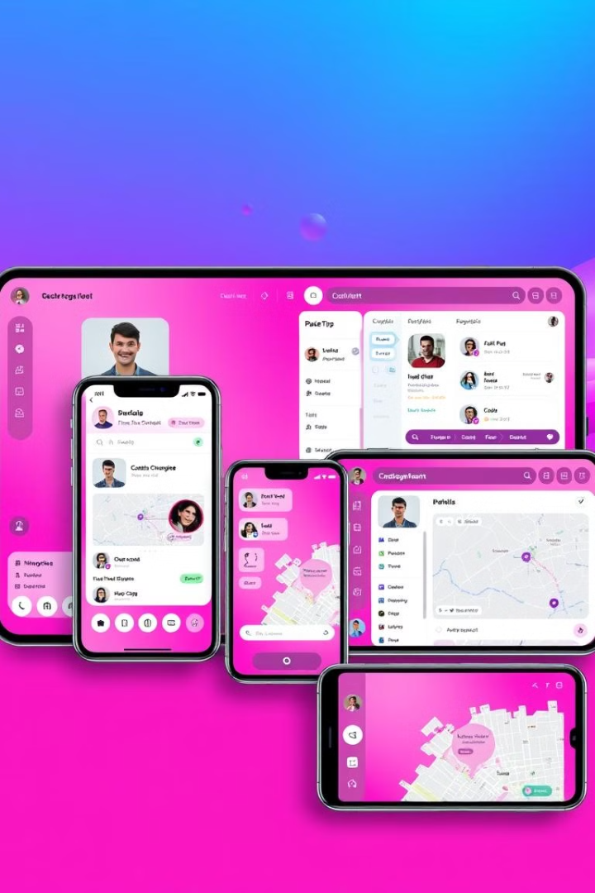
EventConnect: Event Management Platform
EventConnect is a comprehensive platform designed for organizing and attending both virtual and in-person events. This innovative solution combines various technologies to offer a seamless experience for event management, featuring key functionalities such as video calls, live streaming, chat, maps, user authentication, notifications, and event scheduling.

Slide 3
Overview of EventConnect
Virtual and In-Person Events
Key Features
EventConnect is a platform for organizing and attending both virtual and in-person events.
Key features include video calls, live streaming, chat, maps, user authentication, notifications, and event scheduling.

Slide 4

Key Features and Technologies
1
User Authentication
Secure user login and registration using JWT and bcrypt.
2
Video Calls
Use WebRTC for video communication and Socket.io for signaling.
3
Live Streaming
Implement with WebRTC, media servers like Kurento or Jitsi, and HLS for large audiences.

Slide 5
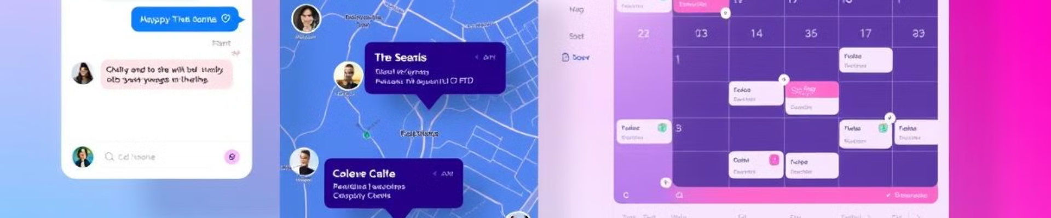
Key Features and Technologies (continued)
1
Real-time Chat
2
Maps Integration
3
Event Scheduling
Real-time messaging with Socket.io and MongoDB.
Use Google Maps API or Leaflet.js to show event locations and navigation.
Manage events with a calendar using FullCalendar.js.

Slide 6
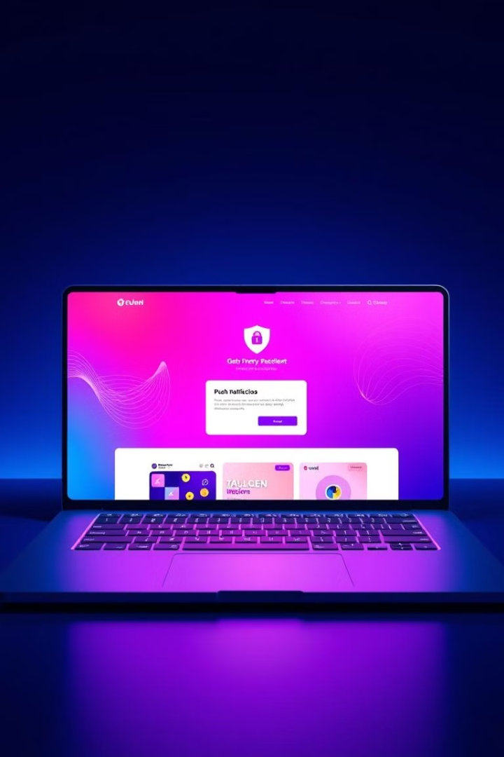
Key Features and Technologies (final part)
1
Notifications System
Notify users with Push.js, Socket.io, or Firebase Cloud Messaging (FCM).
2
Responsive UI/UX
Build a user-friendly interface with React and Material-UI or Bootstrap.
3
Security and Performance
Enhance security with Helmet.js and rate limiting, and use Redis for caching.

Slide 7

Development Process
Planning and Design
1
Define features and create wireframes and database schema.
2
Backend Development
Set up Node.js server, develop APIs, and integrate WebRTC and Socket.io.
Frontend Development
3
Build React components for each feature and integrate with backend APIs.
4
Testing and Deployment
Conduct testing and deploy using platforms like Heroku or AWS.

Slide 8





Target Markets
Event Organizers
Event organizers can use EventConnect to manage their events, from registration to live streaming.
Businesses
Businesses can use EventConnect to host webinars, conferences, and other events.
Educational Institutions
Educational institutions can use EventConnect to host online courses, lectures, and other events.
Community Groups
Community groups can use EventConnect to organize meetings, events, and fundraisers.

Slide 9




Target Markets (continued)
Entertainment Industry
The entertainment industry can use EventConnect to host concerts, festivals, and other events.
Freelancers
Freelancers can use EventConnect to host workshops, webinars, and other events.
Small Businesses
Small businesses can use EventConnect to host networking events, product launches, and other events.

Slide 10
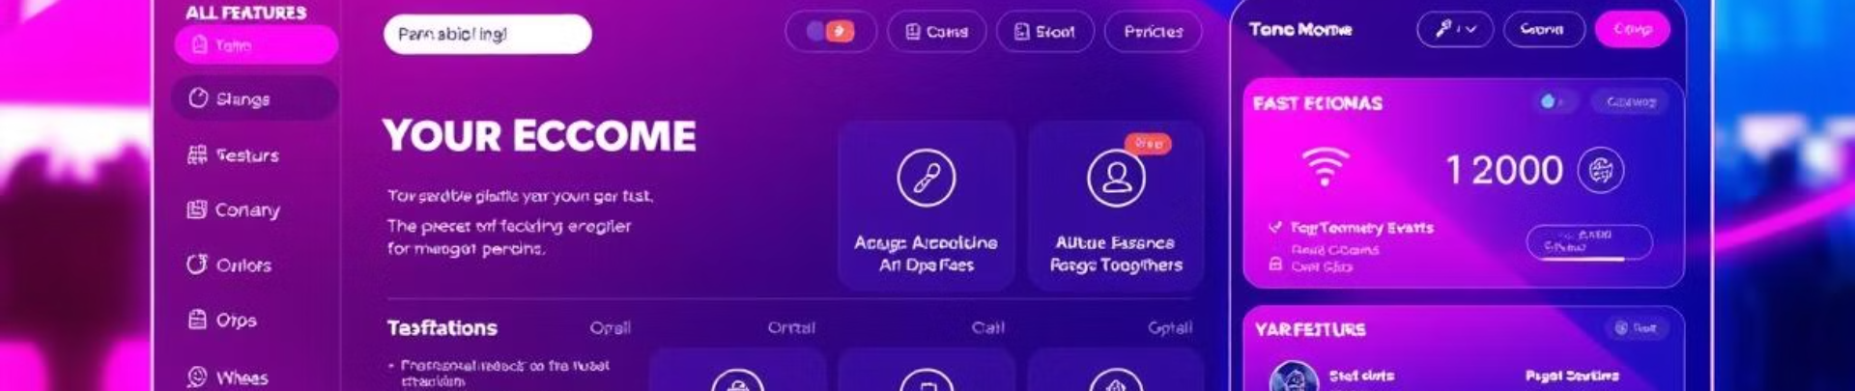
Conclusion
Comprehensive Solution
EventConnect aims to be a comprehensive solution for event management, combining various technologies to offer a seamless experience for organizing and attending events.

Slide 11
Thank You
Appreciation
To wrap things up, We appreciate your interest and participation today.

